Slide 1

The Program's goals are to enrich education by integrating hands-on, inquiry-based instruction, to empower youth to practically apply knowledge at school, home, and in their communities to reduce environmental impact and encourage sustainable practices.
maeoe.org

Slide 2
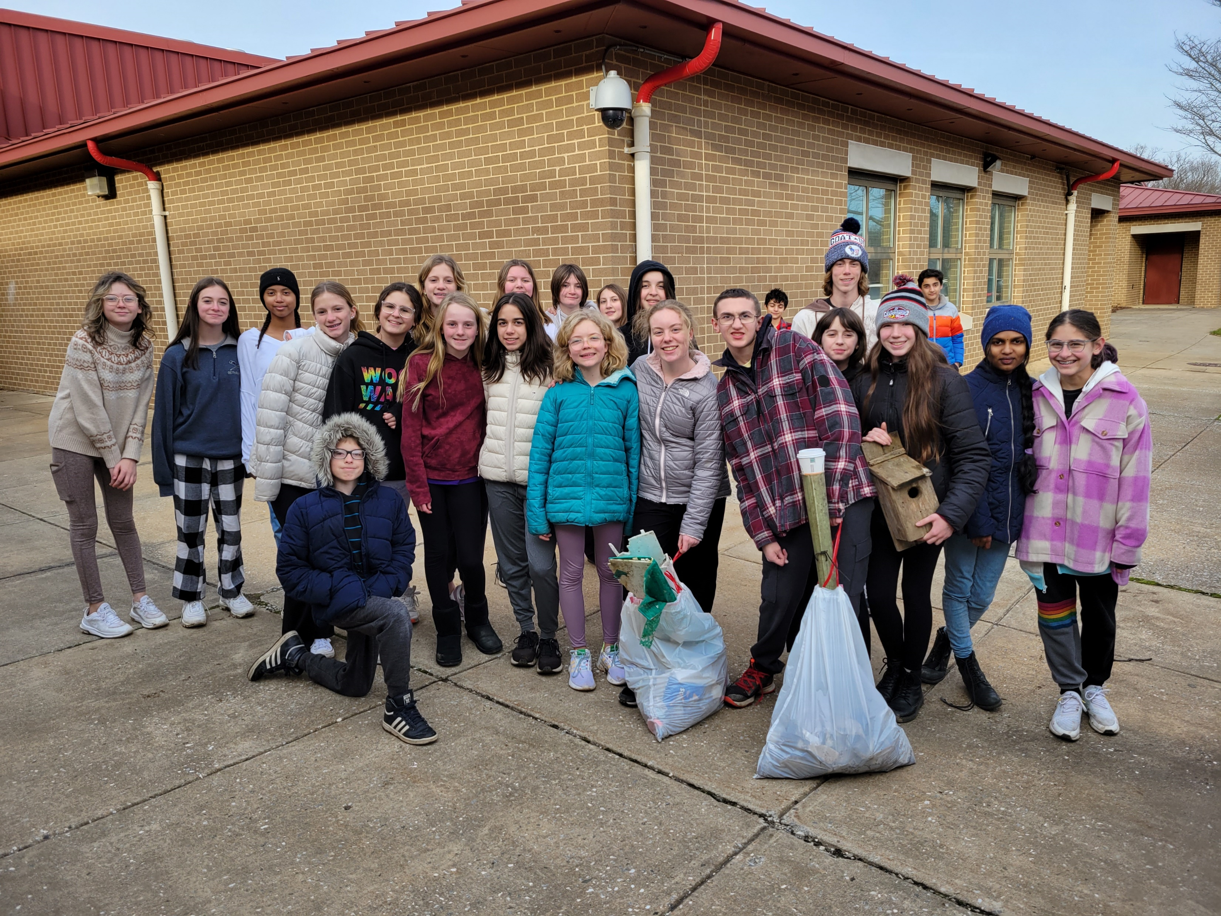
There are currently 680 Maryland Green Schools. This is 36% of approximately 2,200 public and independent schools, there are approximately 430,000 PreK to 12th-grade students attending these schools
Hereford Middle School Certified in 2002, 2006, 2009, 2014*
Schools now re-apply every 4 years

Slide 3
Green School objectives include:
Environmental issue instruction
Professional development
School-wide environmental behavior changes
Celebration of green practices
Water conservation & pollution prevention
Energy conservation
Solid waste reduction
Habitat restoration
Structures for environmental learning
Responsible transportation & reduced emissions
Healthy home and school environments
Citizen/Community Science
Community partnerships

Slide 4
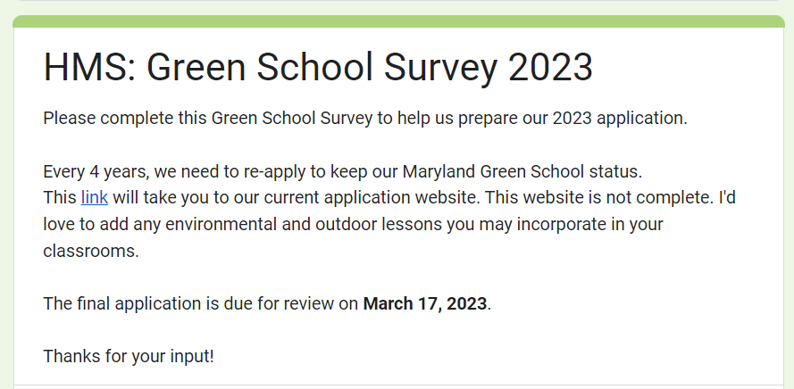
We need your help!
Please complete the survey!
Continue using and promoting Green Practices
Reach out if you’re interested in Green PD

